Slide 1
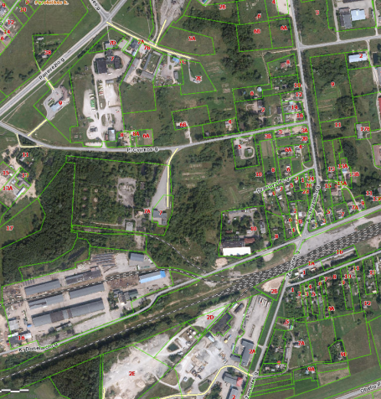

Commercial Land
Rokiskis District Municipality Administration
Plan of the land Photo of the land
Address | Rokiskis town, P.Cvirkos – Donelaičio str. 3
Lot size | 0,6819 Ha
Electricity | 300m distance to substation of power system
Water | 100 m, d100 mm distance to water network
Telecommunications | 40 m distance to internet, telephone network
Distance to the main road | 0,06Km
Price/other conditions | Has not offerred for sale at an auction Detailed plan has prepared Land is commercial

